Slide 1
PLM ECAD Integration Overview
MyPLM.Moog.com
May 2022

Slide 2

Building PLM Capability Over Time
ECAD Integration
Model-Based
Systems Engineering
Mechanical CAD
(Process, Standard Work)
Engineering Documents
(Process, Standard Work)
Electrical CAD
(Process, Standard Work)
Systems
(Process, Standard Work)
Requirements Management
(Process, Standard Work)
Simulation and Analysis
(Process, Standard Work)
Software Engineering
FY20
FY20
FY22
FY23
FY23
FY24
FY25
MCAD/DOC/Foundation Rollout
ECAD Rollout
Requirements Management Rollout
Systems Rollout
PLM Foundation
(Data Model, Workflows, Trade Compliance, Security, data transformation/migration, site DB consolidation, Integration, people data, upgrade)
Ongoing throughout program
Simulation and Analysis Rollout
Software Rollout
Upgrade
Notes:
Technical pieces of PLM – release-one is foundational stuff.
Needs a robust security system.
Lots of gov contracts, foreign countries, UK, Europe, etc.
Need a robust security model so we know who's looking at what and where they are, etc.
Took a few years to build that to get us where we are today.
Workflows are important to engineering to ensure that proper disciplines have reviewed changes.
People data, need to know all users citizenship, where they sit to login, where they live, and more.
First few pillars are "pillars of technology".
Mech CAD and Eng'ing documents (reports, analysis, any documentation).
Since 2020 we've done an upgrade to the Tc solution.
Only released 2 pillars to about 300 people - piloted to small group, northbrook site.
Enhancements are coming out of the testing too plus bug fixes, etc.
Relase one with the upgrade is coming.
FY21 starts ECAD, schematics, elec design work for circuit boards.
Elecs are very complex and there are systems to do that as well.
Requirements mgt (process, standard work) that is tied back to our products.
Engineering Analysis stress and vibration, etc that ensures products work as designed.
FY23 systems engineering and software engineering go hand in hand to round out all the data we capture for our products.
Ultimate goal is the roof - to be a model based systems engineering company. "House of PLM".
Years shown are the years we dev the tech.
After the initial Rollout bar you see here going to early FY23, the rollouts will be incremental
Shifting out to 2025 now so slipping out a bit.
Always enhancements and bug fixes so that is ongoing as we release and start dev on new things.
To be managed very carefully.
The first release will be the largest number of engineers.
After that it should benefit from lessons learned and users will be used to the new system by the next releases.
Pilot in July, training in dec thru jan, but number of users gets less and less over time.
---------Mike Boldt Notes from his Roadmap discussion with leadership-----------------------------------------
Mechanical CAD or MCAD: the design of EH, EHS, and EM actuators, along with servovalves and other major components. Also includes the mechanical portion of electronic controllers.
Engineering Documents: all of the formal, configuration-managed documents produced by Engineering during product development. Currently defined by MRx designations (and several others) and stored in SVN, file shares, Connect/SharePoint, and occasionally even Teamcenter!
Electrical CAD or ECAD: the design of circuit card assemblies and the controllers (boxes) in which they are installed; there is still a question whether or not cable harness assemblies are in scope; process workflows. Does include some circuit simulation and analysis capabilities, but exact scope for this is TBD.
Systems Engineering: functional architecture models (Cameo SysML); dynamic and static physics-based models (MATLAB, Simulink, Amesim); requirements management (DOORS); process workflows to support integration testing; engineering documents; PR management (non-Software related).
Engineering Analysis: integration of structural, thermal, electromagnetic, and fluid dynamics analysis tools and processes; any remaining electronics simulation work.
Software Engineering: code and document CM; process workflows currently defined by AG SEPG and by SDG (?); PR management
Primary goal of Requirements Management pillar is to tightly integrate a requirement to the product, part, design element, and/or report associated with it. Easier (more automated) compliance management; easier (more automated) change management.

Slide 3

ECAD Integration
Strategic Goals
Model Based
Model Based | Move towards model-based definition for digitalization of data and processes
Collaboration Model | Implement a collaboration model that continuously improves cross-operating group and cross-functional synergies
Way of Working | Increase collaboration and interaction between ECAD and MCAD as well as within the specific development activities
Operational Groups | Increase collaboration and interaction between Aircraft and Space and Defense Group
Process Governance | Implement and follow a common integrated, information driven global product lifecycle process, which considers local process variances and uses a common language, input/outputs, rules and definitions
Process Traceability | Create transparency and traceability while designing, validating and changing data during the entire value chain
Process Efficiency | Increase the re-use and efficiency within product development incl. common review and variant management approach
Quality Increase | Drive towards first time right while involving manufacturing and other down stream processes earlier into the process
Common Data Model | Create one common data model including BOI with standardized tools to realize a single source of truth
Data Governance | Support a “go forward only” data governance incl. current and future developments with Cadence
Data Chase | Eliminate data chase while establishing classification and one single source of truth
Collaboration
Process
Tools
3

Slide 4
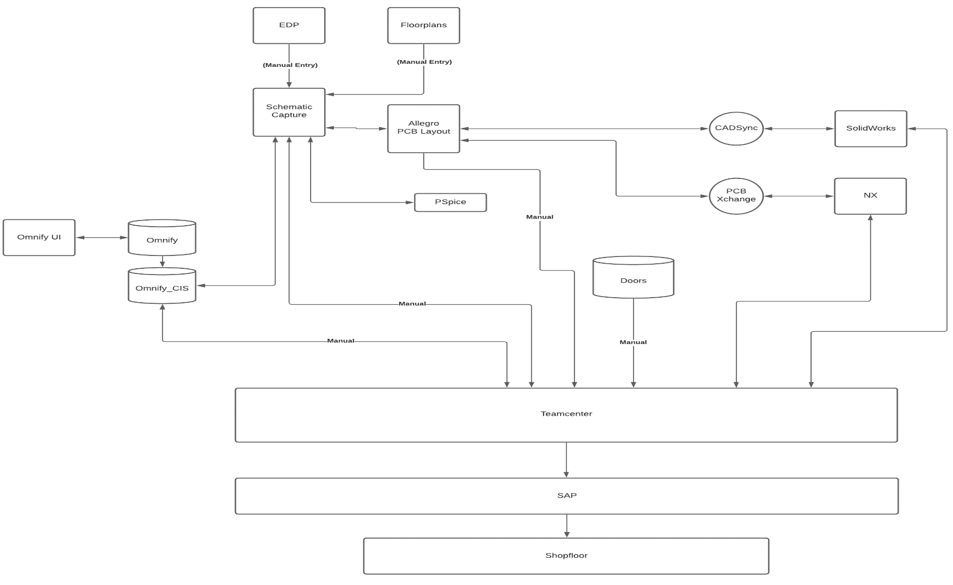
Current IT Architecture
Challenges
Fragmented tool landscape causes lack of collaboration between MCAD and ECAD and within the groups
“Data stored everywhere and anywhere” inside and outside Teamcenter, between locations and groups as well as within the existing tool sets
Lack of Data Singularity and data being ‘rekeyed’ in several places
MBS
4

Slide 5
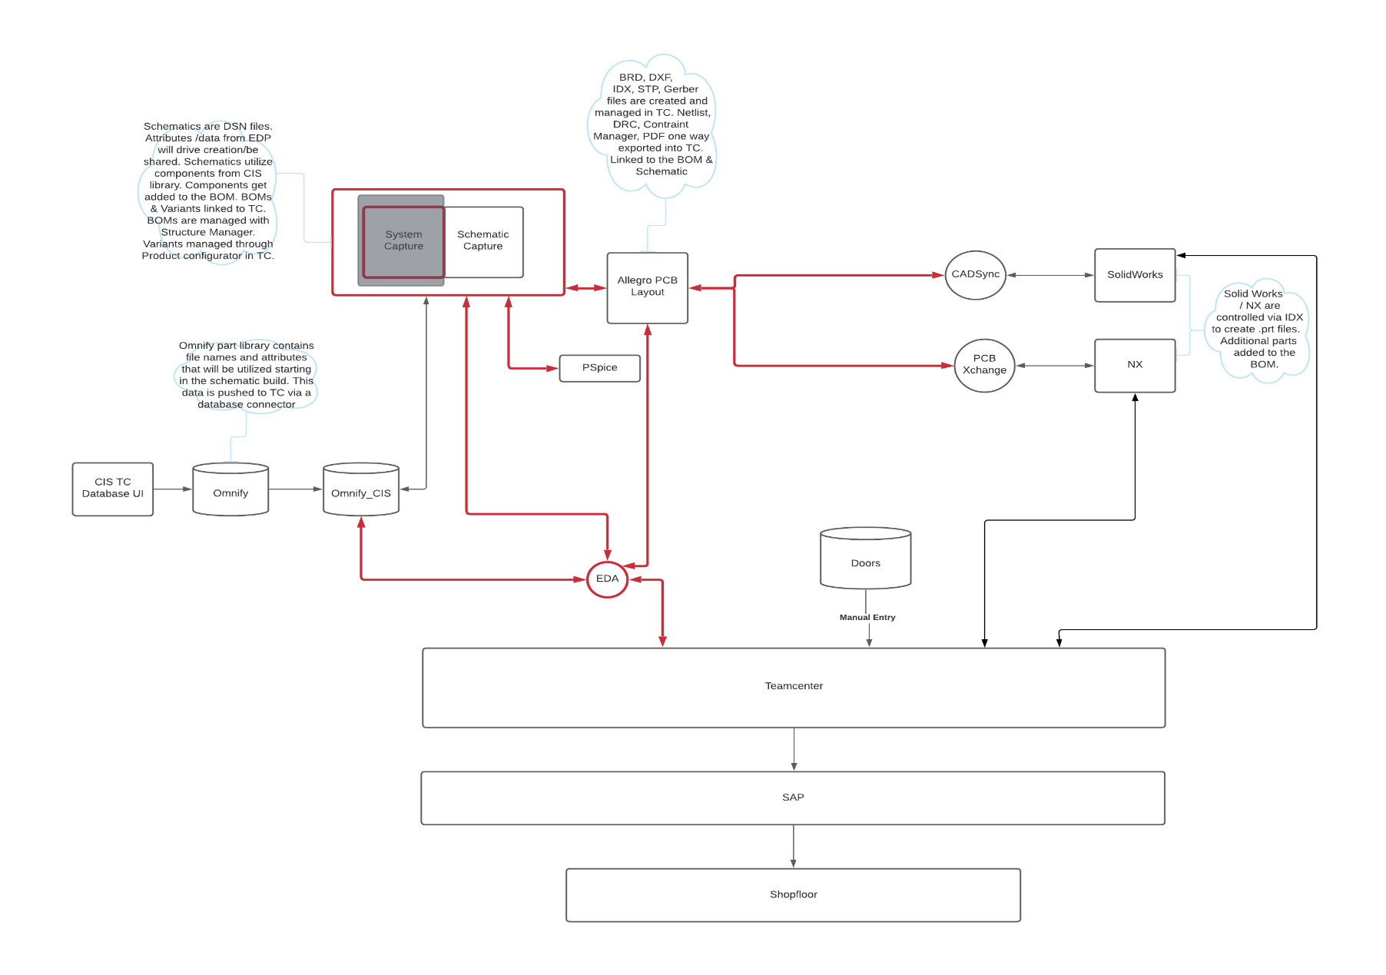
Integrated ECAD Architecture
Main Lift from Integration
Seamless integration of Design, EBOM, MBOM along with variant management
Full system integration, all datasets are housed and controlled in Teamcenter but can be worked with via their native authoring tools
Teamcenter would connect and relate attributes and datasets as needed to develop the necessary BOM information. Single source of truth.
Bi-directional functionality is key to streamlining the process and ensuring accurate data is being passed along development streams
Uses existing CIS Database for electrical components but adds 3D MCAD models thru Teamcenter
Embedded Teamcenter menu into Allegro (Ex: Structure Manager into Cadence UI)
Integrated requirements management capabilities for Schematics, variant management (etc.,…)
5

Slide 6

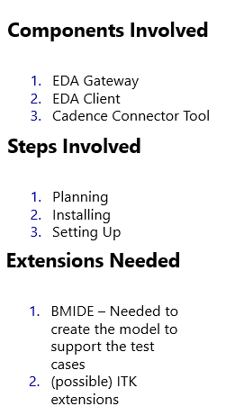
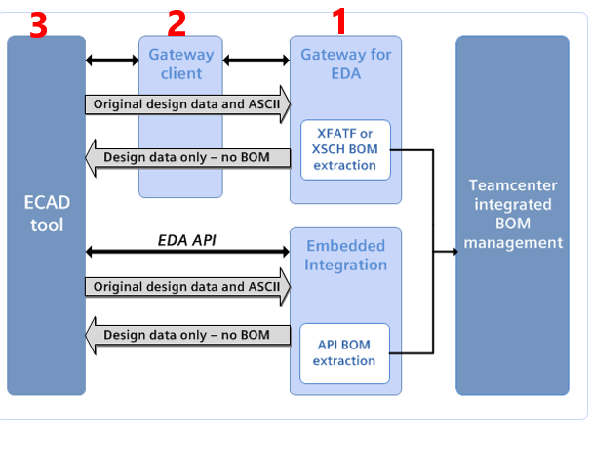
Integrated ECAD Architecture
EDA Gateway Overview, Process and Dataflow
6

Slide 7
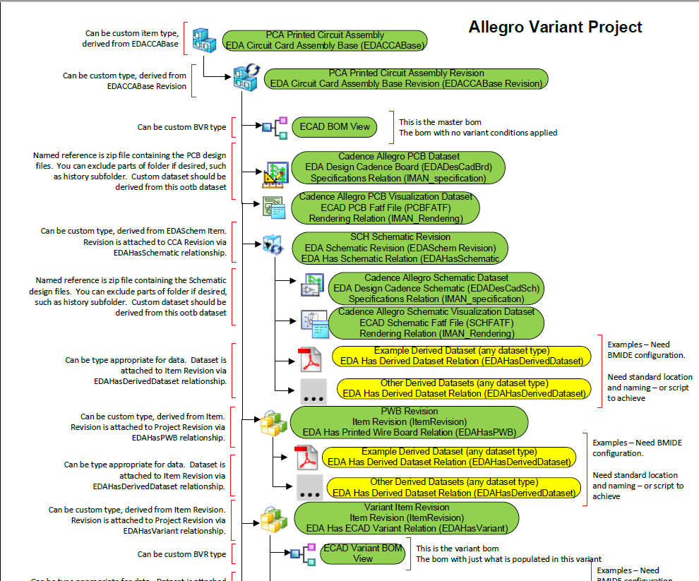
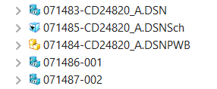
Integrated ECAD Architecture
Standard ECAD Data Model
PCA Assembly
Rev
BOM View
PCB Dataset (Boards)
PCB Visualization (PCBFATF)
Schematic Revision
Sch Dataset
Sch Visualization
Derived Dataset
PWB Revision
Derived Dataset
Variant Item Revision
BOM View
Variant Item Revision
BOM View
7

Slide 8
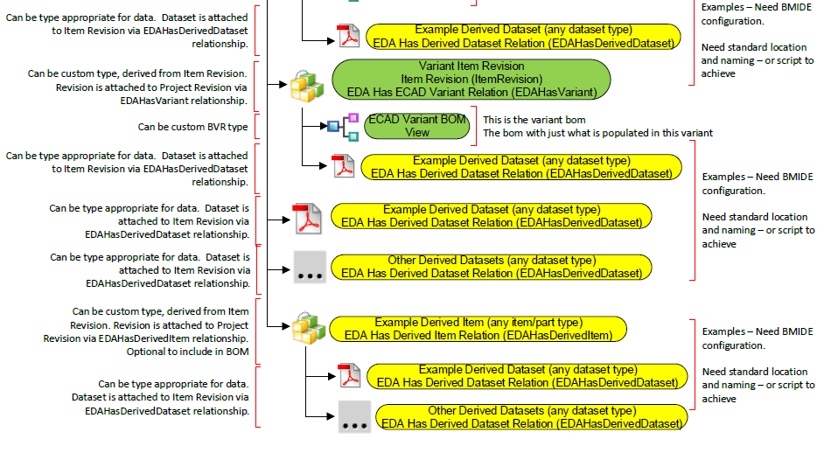
Integrated ECAD Architecture
Standard ECAD Data Model
8

Slide 9
Integrated ECAD Architecture
Toolset
Schematic Capture
PCB Layout
MCAD
OrCAD
(System Capture) – Future State
Cadence Allegro
NX
Solidworks
9

Slide 10
ECAD Integration - Highlights
Schematic
Stored in Teamcenter, open, close, check in and check-out from within OrCAD menu
Enter data once philosophy, title block information imported/exported from originating source
Mechanical and alternate parts managed through schematic table
BOM and design variants authored and managed through a single core schematic
BOM and pdf (both smart and dumb, depending on the consumer) generated at each check-in
Automatic and/or manual versioning at each check-in/commit
Single-click publish to Teamcenter (EO/ECN release)
EDP (Engineering Data Package)
Stored in Teamcenter, open, close, check in and check-out from within OrCAD menu
Specification integrated with check lists and drawing notes
Enter data once philosophy
Information imported/exported from originating source
10

Slide 11
ECAD Integration - Highlights
Printed Wiring Board
Stored in Teamcenter, open, close, check in and check-out from within Allegro menu
Bi-directional, incremental transfer of idx data between ECAD and MCAD (Allegro – NX/SW)
Single Allegro “model based” brd file contains all data required to manufacture, build and test bare board PWB as well as completed CCA (Circuit Card Assembly)
Revised work-flow compatible with entire Moog enterprise
3D models added to existing ECAD Global Library (accessible to Allegro and NX/SW users)
Enter data once philosophy, title block information, fabrication notes etc. imported/exported from originating source
Single click reporting and check lists, including automatic component density calculation (Fit Check)
Allegro menu driven e-mail triggers for collaboration with pre-assigned team members
Auto-generation of data-table, cross-section and fabrication notes
Single click netlist synchronization and ECO report
Single click derived outputs and publish/release
11

Slide 12
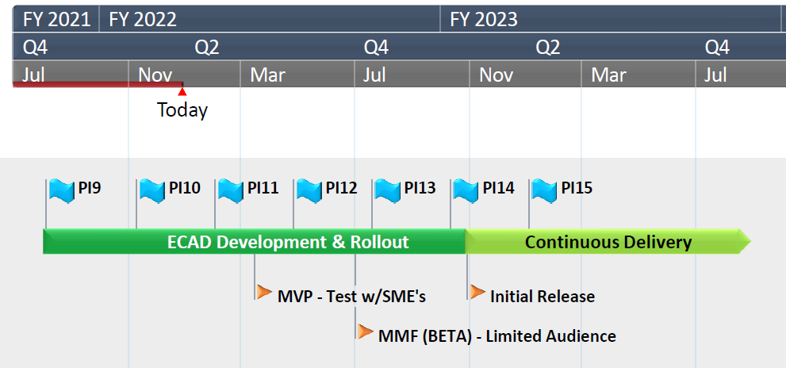
ECAD Integration
Timeline
MVP (~May 2022) – Development Env, testing with SMEs for Proof of Concept and testing use cases
MMF (~July 2022) – Production, limited set of users to verify technology and core processes
Initial Release (~Nov 2022) – Production, wide rollout to all users as sites are onboarded or trained
12

Slide 13


Thank You
For additional information, please contact:
Chris Simmonds: csimmonds@moog.com
Bill Kopp: wkopp@moog.com
Paul Prehl (MHP): paul.prehl@mhp.com
MyPLM.Moog.com
13

